Slide 1
Tools, Frameworks & Resources You Broke It. Now What?
Pavan Reddy
Principal Developer, Automata

Slide 2
The Good News
You Don't Need to Reinvent the Wheel
Every vulnerability we exploited today already maps to an existing security control.
What We Attacked | What Already Exists
Prompt Injection on SQL Agent | SI-10, AC-6, CM-7 (NIST 800-53)
EchoLeak Zero-Click Exfil | SC-7, SI-15, AU-2 (NIST 800-53)
Model Theft via Distillation | SA-04, AC-3, AU-3 (NIST 800-53)
Notes:
Here's the single most important thing I want you to take away today: we do NOT need an entirely new security framework for AI. I know that sounds counterintuitive. AI feels new. The attacks feel new. But look at what we actually did today. When we exploited the SQL Agent, the fix was least privilege and input validation — AC-6 and SI-10 from NIST 800-53. Controls that have existed since 2005. When EchoLeak exfiltrated data through rendered markdown, the fix was boundary protection and output filtering — SC-7 and SI-15. These aren't AI-specific inventions. They're security fundamentals applied to a new context. The wheel exists. We just need to point it at AI. And that's exactly what's happening right now across the industry.

Slide 3
NIST 800-53: The Control Catalog You Already Know
NIST SP 800-53 → AI: The Mapping Already Exists
What’s already covered:
What's New for AI:
Control | What it Covers
AC-6 | Least Privilege → Agent permissions
SI-10 | Input Validation → Prompt sanitization
SC-7 | Boundary Protection → Egress controls, classifiers
AU-2/AU-3 | Audit Logging → Query & decision logging
IR-4 | Incident Response → AI-specific runbooks
CM-7 | Least Functionality → Stored procedures, tool restrictions
Control | What it Covers
NIST IR 8596 | Cyber AI Profile (Preliminary Draft, Dec 2025)
NIST IR 8605 | Control Overlays for Securing AI Systems
SP 800-53 Release 5.2.0 (Aug 2025) | New AI-related controls
Notes:
We mapped every attack in this workshop to 800-53 controls — you saw the tables at the end of each module. That wasn't an exercise. That was me showing you that the infrastructure to secure AI already exists in the compliance framework most of you are already audited against. But NIST isn't stopping there. In December 2025, they released the preliminary draft of the Cyber AI Profile — NIST IR 8596. This is huge. It takes the Cybersecurity Framework 2.0 and extends it specifically for AI, organized around three focus areas: Securing AI systems, using AI for cyber defense, and thwarting adversarial AI attacks. They also released IR 8605 — Control Overlays specifically for securing AI systems, which maps directly to 800-53 controls. And in August 2025, 800-53 itself got Release 5.2.0 with new controls that address secure patches and AI-related supply chain concerns. The message from NIST is clear: don't build a new house. Renovate the one you're in.

Slide 4
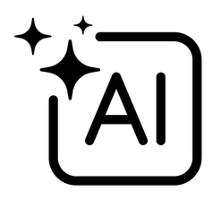
The Framework Landscape
The Framework Ecosystem: They All Talk to Each Other
MITRE ATLAS
ISO/IEC 42001
Adversary tactics & techniques (ATT&CK for AI)
Certifiable AI management system
NIST AI RMF 1.0
EU AI Act
Govern, Map, Measure, Manage
Risk-based regulation (if operating in EU)
NIST 800-53 + Cyber AI Profile
OWASP Top 10 for LLMs
Technical controls
Vulnerability awareness
Notes:
Let me walk you through how these frameworks actually fit together, because it looks overwhelming until you realize they're all doing different jobs. NIST AI RMF 1.0, released January 2023, is the strategic layer. Four functions: Govern, Map, Measure, Manage. It's how you build an AI risk culture. It's voluntary, flexible, and it's being revised right now. NIST 800-53 and the new Cyber AI Profile are the technical controls layer. This is where the rubber meets the road — what you actually implement. OWASP Top 10 for LLMs, updated for 2025, is your vulnerability awareness layer. Prompt injection is still number one. The 2025 version added Vector and Embedding Weaknesses and System Prompt Leakage. Everything we attacked today is on that list. MITRE ATLAS is your adversary intelligence layer. Think of it as ATT&CK for AI — 15 tactics, 66 techniques, and they just added 14 new techniques in early 2026 specifically for agentic AI threats. ISO 42001 is for organizations that want a certifiable AI management system. And the EU AI Act is the regulatory hammer if you operate in Europe. Here's the key: NIST published crosswalks between all of these. They map to each other. You pick the ones relevant to your context, and they stack.

Slide 5
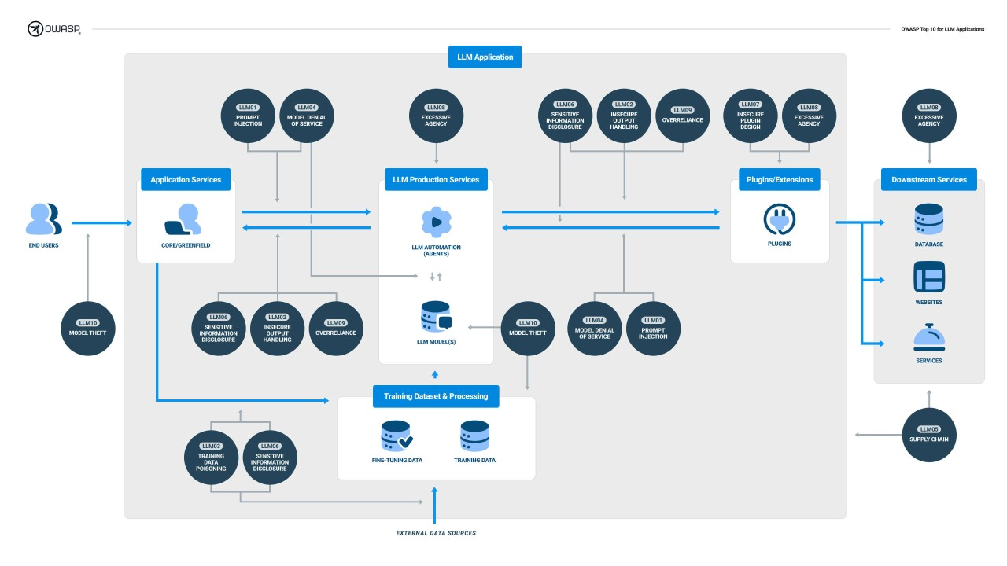
OWASP Top 10 for LLMs (2025)
The Framework Ecosystem: They All Talk to Each Other
Source: https://genai.owasp.org/2023/10/18/llm-to-10-v1-1/
Notes:
Look at this list. Prompt injection — still number one. We broke every system in this workshop with some form of it. Sensitive Information Disclosure — that was EchoLeak. Data and Model Poisoning — we covered that. Improper Output Handling — that was the rendered markdown attack. Excessive Agency — that was the SQL Agent running UPDATE queries because nobody told it not to. System Prompt Leakage is new for 2025 — and you saw how we extracted system prompts. Vector and Embedding Weaknesses is also new — as RAG systems become standard, the vector databases backing them become attack surfaces. We executed six of these ten categories live today. This isn't theory. This is your Tuesday.

Slide 6
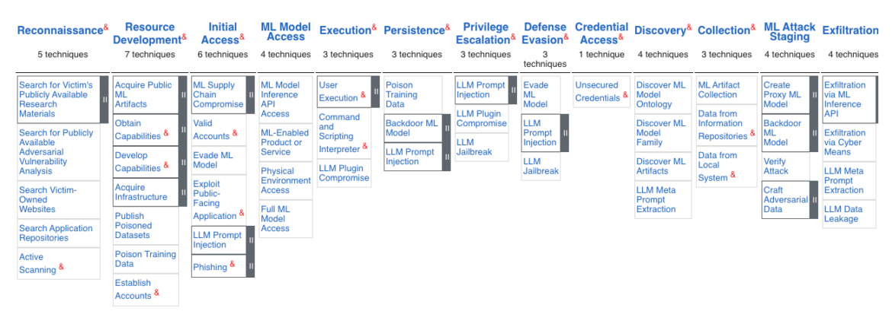
MITRE ATLAS: ATT&CK for AI
MITRE ATLAS — Know Your Adversary
15 Tactics 66 Techniques 46 Sub-techniques
14 NEW agentic AI techniques added in 2026
What it is: An adversary-centric knowledge base for AI/ML threats, modeled after ATT&CK
Key addition for 2026: Techniques for AI agents that invoke tools, access APIs, authenticate to services, and make decisions without human oversight
Notes:
Look at this list. Prompt injection — still number one. We broke every system in this workshop with some form of it. Sensitive Information Disclosure — that was EchoLeak. Data and Model Poisoning — we covered that. Improper Output Handling — that was the rendered markdown attack. Excessive Agency — that was the SQL Agent running UPDATE queries because nobody told it not to. System Prompt Leakage is new for 2025 — and you saw how we extracted system prompts. Vector and Embedding Weaknesses is also new — as RAG systems become standard, the vector databases backing them become attack surfaces. We executed six of these ten categories live today. This isn't theory. This is your Tuesday.

Slide 7
The Tools Arsenal
Your Red Team & Blue Team Toolkit
Red Team
Blue Team
Tool | What It Does | License / Notes
Promptfoo | Context-aware LLM red teaming, CI/CD integration, maps to OWASP/NIST/ATLAS | MIT (acquired by OpenAI, March 2026 — staying open source)
Garak (NVIDIA) | 120+ probe modules, LLM vulnerability scanner | Apache 2.0
PyRIT (Microsoft) | Python Risk Identification Tool, multi-modal & multi-turn attack orchestration | Open source
FuzzyAI | Genetic algorithm prompt fuzzing, discovers unknown attack vectors | Open source
DeepTeam (Confident AI) | Red teaming framework with OWASP & MITRE ATLAS modules | Open source
Tool | What It Does | License / Notes
Tool | What It Does | License / Notes
LLM Guard (Protect AI) | Runtime input/output scanning — 15 input + 20 output scanners | Open source
NeMo Guardrails (NVIDIA) | Programmable guardrails for LLM applications | Open source
Rebuff | Self-hardening prompt injection detection | Open source
Lakera Guard | Managed API for real-time prompt injection defense | Commercial (free tier available)
ART (IBM) | Adversarial Robustness Toolbox for ML models | Open source
Tool | What It Does | License / Notes
Notes:
Let's talk tools. I'm going to give you the actual weapons you can use starting tonight. On the red team side: Promptfoo is the big one right now. OpenAI literally acquired them last week — March 2026. It generates thousands of context-aware attacks tailored to your specific application. It maps findings to OWASP, NIST RMF, MITRE ATLAS, and the EU AI Act. And the core tool stays open source. Garak, backed by NVIDIA, is your dedicated vulnerability scanner — 120+ probe modules, covers everything from DAN jailbreaks to encoding bypasses to training data extraction. PyRIT from Microsoft is great for multi-modal and multi-turn attack orchestration. On the blue team side: LLM Guard gives you runtime protection — it sits between your app and the LLM and scans both inputs and outputs. NeMo Guardrails from NVIDIA lets you define programmable guardrails. And if you remember our cost discussion from the SQL Agent section — classifiers as a security layer — these tools are how you build that pipeline. Every single one of these is either open source or has a free tier. You have no excuse not to start testing.

Slide 8
The Policy Landscape (Where Things Stand)
Federal
State
International
What | Status
Comprehensive federal AI law | Does not exist
EO: "Ensuring a National Policy Framework for AI" (Dec 2025) | Aims to preempt state laws, establish "minimally burdensome national standard"
DOJ AI Litigation Task Force (Jan 2026) | Challenges state AI laws on constitutional grounds
Biden's EO 14110 (safety-focused) | Revoked; replaced with "innovation-first" approach
NIST AI RMF + Cyber AI Profile | De facto technical standard — voluntary, bipartisan, framework-level
What | Status
State / Bill | Status
45+ states | Introduced AI-related bills in 2024
California TFAIA | Effective January 1, 2026
Texas RAIGA | Effective January 1, 2026
Colorado AI Act (SB 24-205) | Delayed to June 30, 2026
Illinois HB 3773 | Prohibits AI-based hiring discrimination
State / Bill | Status
Framework / Regulation | Scope
EU AI Act | Risk-based regulation; high-risk obligations phasing in 2026–2027
ISO/IEC 42001 | Certifiable AI management system standard
OECD AI Principles | Global alignment baseline; maps to NIST AI RMF
Framework / Regulation | Scope
EU AI Act | Risk-based regulation; high-risk obligations phasing in 2026–2027
ISO/IEC 42001 | Certifiable AI management system standard
Notes:
Here's where we are on policy, and I'm not going to sugarcoat it — it's a mess. The US has no comprehensive federal AI law. President Trump signed an executive order in December 2025 called "Ensuring a National Policy Framework for AI." The stated goal is a "minimally burdensome national standard." In practice, it created a DOJ task force to sue states whose AI laws the administration considers too restrictive. It also threatens to pull broadband funding from states with "onerous" AI laws. Meanwhile, states aren't waiting. California and Texas laws went live January 1st. Colorado's AI Act, which requires reasonable care to prevent algorithmic discrimination, got delayed to June 2026 — partly because of this federal pressure. Over 45 states introduced AI bills last year. On the international side, the EU AI Act is phasing in, with high-risk AI obligations hitting in 2026 and 2027. Here's what this means for you as security practitioners: the regulatory ground is shifting under your feet. The frameworks — NIST, OWASP, ATLAS — are your stable ground. They're voluntary, they're technically sound, and they don't depend on which party is in the White House. Build your program on the frameworks, and you'll survive any policy earthquake.

Slide 9
Policy: What This Means For You
Policy Translation: What Should You Actually Do?
Don't wait for Congress. Frameworks like NIST AI RMF and 800-53 are your actionable compliance foundation today. They don't require legislation to implement.
Design for the strictest standard. If you build to EU AI Act + NIST + OWASP standards, you're covered no matter what the US does.
Document everything. The one thing every regulation agrees on: you need an audit trail. Log every query, every decision, every permission denial. IR-4. AU-2. AU-3.
Notes:
So what do you actually do in this chaos? Three things. First — don't wait for Congress. If you're waiting for a federal AI law to tell you what to do, you're going to be waiting a long time, and you'll be unprotected the whole time. NIST AI RMF is voluntary. 800-53 controls are well-understood. Implement them now. Second — design for the strictest standard you might face. If you build your AI governance to satisfy the EU AI Act, NIST, AND OWASP, you're covered regardless of what happens in US policy. The cost of building to a higher standard is marginal. The cost of rebuilding after a breach or a regulatory surprise is catastrophic. Third — document everything. This is the one universal truth across every framework, every regulation, every standard on this planet. If you can't prove it, it didn't happen. Log every generated query, every classifier decision, every permission denial. AU-2, AU-3, IR-4. We covered this in every single module today. It's not a coincidence.

Slide 10
Why This Matters
The Microsoft Copilot Story
June 2025: Researchers discovered a zero-click vulnerability in Microsoft 365 Copilot.
A single email — never opened, never clicked — triggered data exfiltration through the AI assistant.
The attack used every technique we covered today: Indirect prompt injection → hidden in email content Data exfiltration → embedded in a rendered image URL CSP bypass → via an allowlisted Microsoft domain Zero-click → automatic rendering, no user action needed
This wasn't a demo. This was production.
Notes:
So what do you actually do in this chaos? Three things. First — don't wait for Congress. If you're waiting for a federal AI law to tell you what to do, you're going to be waiting a long time, and you'll be unprotected the whole time. NIST AI RMF is voluntary. 800-53 controls are well-understood. Implement them now. Second — design for the strictest standard you might face. If you build your AI governance to satisfy the EU AI Act, NIST, AND OWASP, you're covered regardless of what happens in US policy. The cost of building to a higher standard is marginal. The cost of rebuilding after a breach or a regulatory surprise is catastrophic. Third — document everything. This is the one universal truth across every framework, every regulation, every standard on this planet. If you can't prove it, it didn't happen. Log every generated query, every classifier decision, every permission denial. AU-2, AU-3, IR-4. We covered this in every single module today. It's not a coincidence.

Slide 11
The Closing: Your Mission
Your Mission, Should You Choose to Accept It
Go test something. Pick one AI system at your org. Run Promptfoo or Garak against it. See what breaks.
Go map something. Take one vulnerability you found today. Map it to NIST 800-53.
Go build something. Deploy one classifier. Add one guardrail. Write one AI incident response runbook.
Go teach someone. You now know more about AI security than 95% of the industry. Spread it.
Notes:
We started today by saying you didn't need any background. You came to break stuff. And you did. You injected prompts into SQL agents and watched them run unauthorized queries. You exfiltrated data through invisible image tags. You stole models. You poisoned training data. You fooled stop signs. But breaking stuff was never the point. The point was to understand the attacks so deeply that you can defend against them. And now you can. You have the frameworks: NIST AI RMF, 800-53, OWASP Top 10, MITRE ATLAS. You have the tools: Promptfoo, Garak, PyRIT, LLM Guard. You have the knowledge: every attack we ran today maps to controls that exist right now. So here's what I want you to do. Go test something — pick one AI system at your org and red team it. Go map something — take one vulnerability and map it to a NIST control and show it to your CISO. Go build something — deploy one defensive layer. Go teach someone — because you now know more about AI security than the vast majority of people in this industry. AI is moving fast. The attackers are moving fast. But after today, so are you. Thank you.

Slide 12
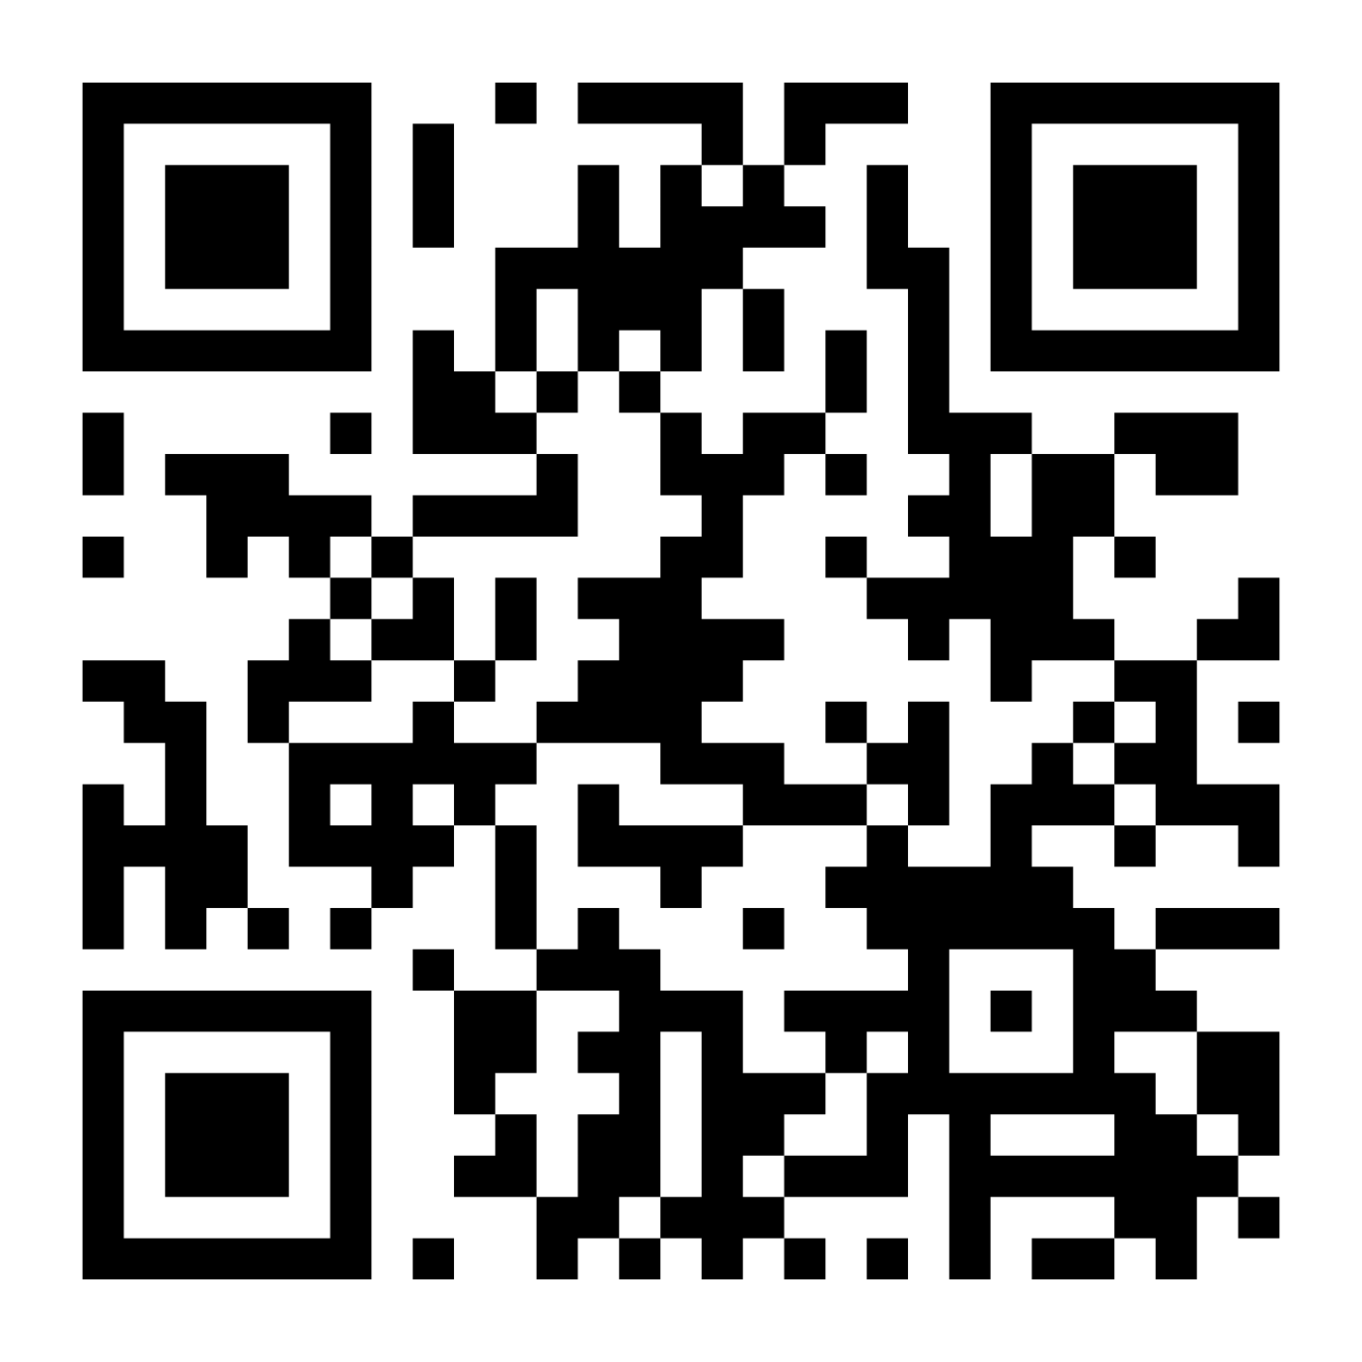
Your Feedback is Really Appreciated
This helps create better content material and improve the quality of workshops.
Est Time: 2-4 mins
Notes:
We started today by saying you didn't need any background. You came to break stuff. And you did. You injected prompts into SQL agents and watched them run unauthorized queries. You exfiltrated data through invisible image tags. You stole models. You poisoned training data. You fooled stop signs. But breaking stuff was never the point. The point was to understand the attacks so deeply that you can defend against them. And now you can. You have the frameworks: NIST AI RMF, 800-53, OWASP Top 10, MITRE ATLAS. You have the tools: Promptfoo, Garak, PyRIT, LLM Guard. You have the knowledge: every attack we ran today maps to controls that exist right now. So here's what I want you to do. Go test something — pick one AI system at your org and red team it. Go map something — take one vulnerability and map it to a NIST control and show it to your CISO. Go build something — deploy one defensive layer. Go teach someone — because you now know more about AI security than the vast majority of people in this industry. AI is moving fast. The attackers are moving fast. But after today, so are you. Thank you.

Slide 13
Thank You
Content: Pavan Reddy Principal Developer, AutomataSecure
Workshop materials: [your link here]
[Your social handles / contact info]

